Slide 1
Topic: Geometry and Mapping EQ: How can we use map scales to figure out real life distances?
Year 11 Mathematics Essentials

Slide 2
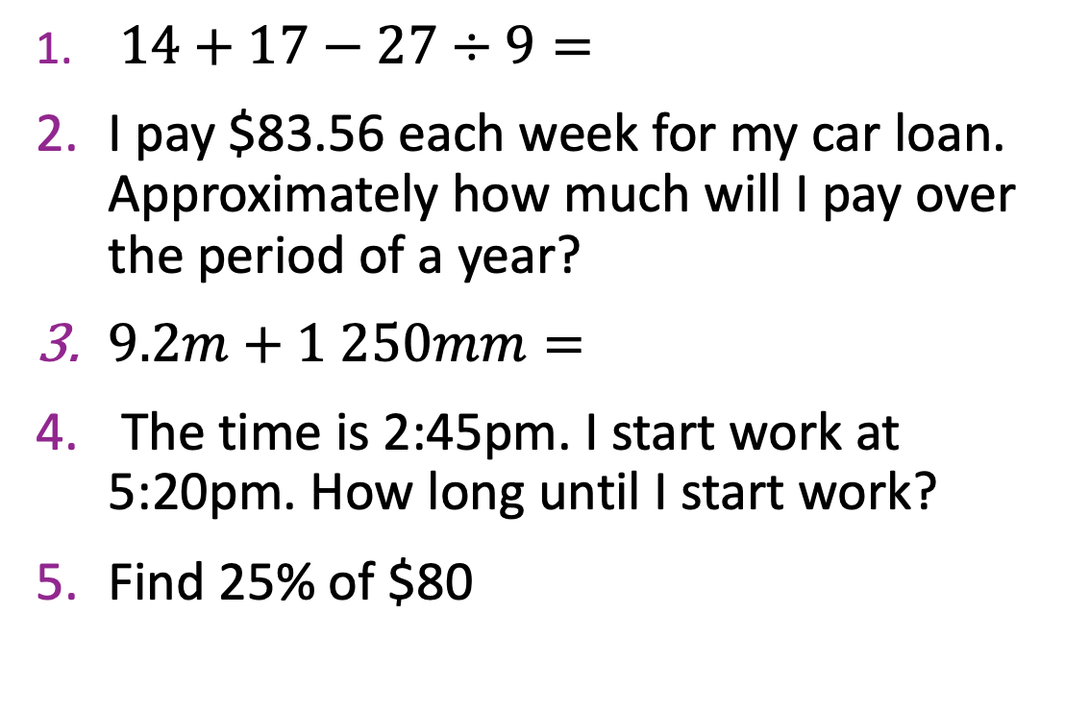
Five Questions
Topic: Geometry and Mapping
EQ – How can we apply our knowledge of scale ratios to figure out real life distances?
$14+17−27÷9=$
I pay $83.56 each week for my car loan. Approximately how much will I pay over the period of a year?
$9.2m+1 250mm=$
The time is 2:45pm. I start work at 5:20pm. How long until I start work?
Find 25% of $80
28
~ $4 345.12
21.35m or 21 350mm
2hrs 25min
$20

Slide 3
24
7
30
Date: XX/XX/2021
Topic: Geometry and Mapping
EQ – How can we apply our knowledge of scale ratios to figure out real life distances?
When travelling from destination to destination to save time and energy we want to choose the shortest path.
To problem of finding the shortest path between two intersections on a road map you need to
Plan a route (Starting point to destination).
Measure the distance on map
Use the scale to calculate the real distance in m / km
Relationship Table helps us convert
cm on map | Real Distance (m) | Real Distance (km)
WICOR

Slide 4
24
7
30
Date: XX/XX/2021
Topic: Geometry and Mapping
EQ – How can we apply our knowledge of scale ratios to figure out real life distances?
TASK:
Using the map on page 124, answer the following questions:
Calculate the shortest possible path between A and B, B and C, and A and C.
Which school is closest to A? What is the distance?
Which church is closest to B? What is the distance?
Which point (A,B or C) is closest to a railway crossing? Explain.
Starting at point A, a person travels to the post office, the school at C4 and finishes at the playground. What is the shortest route?
WICOR

Slide 5
Further Practise:
Complete the worksheet on networks and shortest paths..

